Slide 1

CODE OF ETHICS OF A CIPHERESPHERE TECHNOLOGIES COMPANY
Course: Engineering Ethics [B]
Instructor: Kazi Firoz Ahmed
Presented By: Rifah Sanzida
ID: 22-47154-1
Department: CSE

Slide 2

Code of Ethics: Cipheresphere Technologies
This presentation outlines the ethical principles that guide Cipheresphere Technologies, a company dedicated to secure and responsible innovation in the digital realm. As a leader in the technology industry, Cipheresphere is committed to upholding the highest standards of integrity, equity, and transparency in all aspects of its operations.
At the core of Cipheresphere's mission is a deep-rooted belief in the power of technology to improve people's lives. However, the company recognizes that with great power comes great responsibility. Cipheresphere's code of ethics serves as a guiding light, ensuring that the company's innovations are not only technologically advanced but also ethically sound and socially conscious.

Slide 3
Company Details
Mission
Vision
At the heart of Cipheresphere Technologies' mission is a steadfast commitment to empowering individuals and organizations with secure and reliable digital solutions. As a leading innovator in the technology industry, Cipheresphere recognizes the profound impact that its products and services can have on people's lives, and it has made a solemn pledge to wield this power responsibly and ethically.
Cipheresphere Technologies aspires to be a global leader in the development of ethical and responsible technology solutions. This ambitious goal is rooted in the company's unwavering commitment to harnessing the transformative power of digital innovation to improve people's lives, while steadfastly upholding the highest standards of integrity, transparency, equity, and inclusion.

Slide 4


Objective: Secure & Responsible Innovation
Cipheresphere Technologies aims to develop and deliver cutting-edge digital solutions that prioritize security, privacy, and ethical considerations.

Slide 5

Aims & Goals
1
1. Secure Data Infrastructure
2
2. Ethical AI Development
Promote responsible and unbiased artificial intelligence development and deployment.
Develop robust security measures to protect sensitive data and user privacy.
3
3. Sustainable Technology
Minimize environmental impact through energy-efficient practices and responsible resource management.

Slide 6

How We Operate
Cipheresphere Technologies operates with a strong focus on transparency, collaboration, and continuous improvement. We value open communication, diverse perspectives, and a commitment to ethical practices.

Slide 7
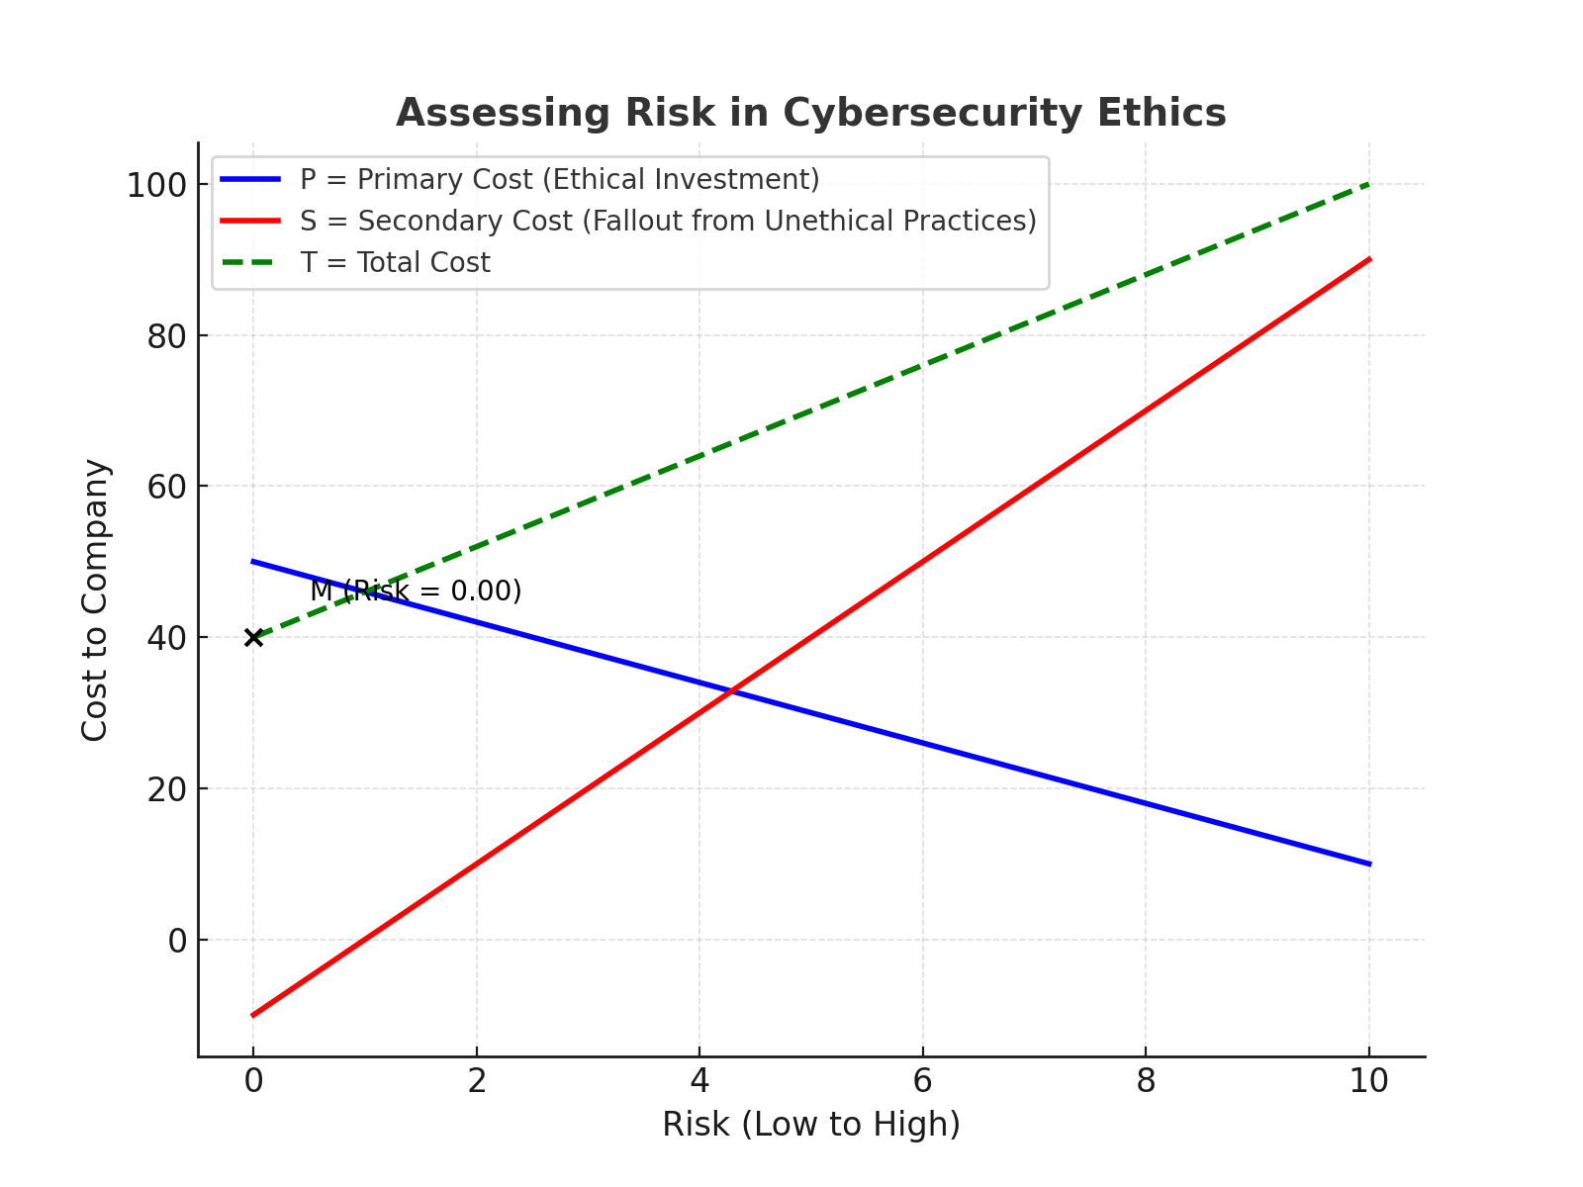

Slide 8

Code of Ethics
Our code of ethics serves as a guiding framework for all our actions and decisions. It embodies our commitment to integrity, respect, and responsible innovation.

Slide 9

Integrity & Transparency
Honest Communication
Accountability
We take responsibility for our actions and decisions, upholding the highest standards of ethical conduct.
We strive for open and honest communication with our stakeholders, ensuring transparency in all our operations.

Slide 10


Equity & Inclusion
Cipheresphere Technologies is committed to fostering a diverse and inclusive workplace where everyone feels valued, respected, and empowered to contribute their unique talents.

Slide 11

Conclusion
By adhering to our code of ethics, Cipheresphere Technologies strives to be a responsible and ethical leader in the digital world. We believe that technology can be a force for good, and we are committed to using our expertise to create a more secure, equitable, and sustainable future.

